Slide 1
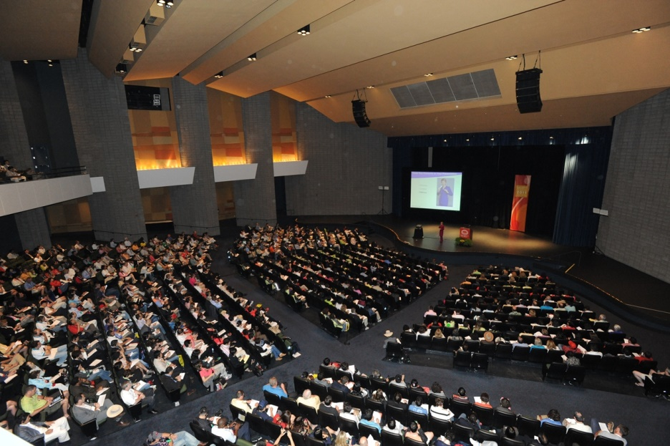
Creating Your First Speaking Opportunity
Steve Jones
Notes:
Start ZoomIt
Start SSMS
- Load Encryption TDE demo
Open sample PPT deck

Slide 2
Agenda
Goals
Why Speak?
Who am I?
Choosing a topic
Writing an abstract
Finding a place to talk
Building a deck
Demos
Practice
Summary

Slide 3
Goals
Motivate you
Give you confidence
Give you a few practical tips

Slide 4
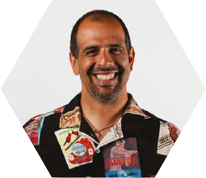



Get in touch
Editor and founder, SQLServerCentral
Evangelist, Red Gate Software
Working with SQL Server since 1991 (v4.2)
Author of many articles and books on different aspects of SQL Server
Steve Jones
http://voiceofthedba.wordpress.com/
sjones@sqlservercentral.com
@way0utwest

Slide 5

Why Speak?

Slide 6
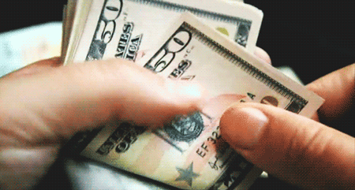
Why Speak?

Slide 7

Choosing a Topic

Slide 8
What did you do last week?

Slide 9
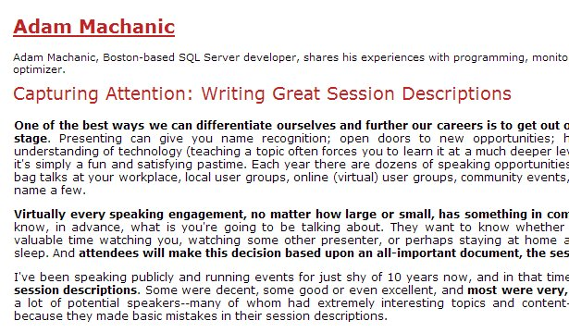
Writing an Abstract
http://sqlblog.com/blogs/adam_machanic/archive/2013/02/22/capturing-attention-writing-great-session-descriptions.aspx
http://bit.ly/1xtdncL

Slide 10
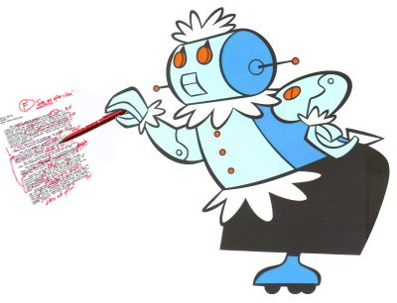
Use a Friend

Slide 11
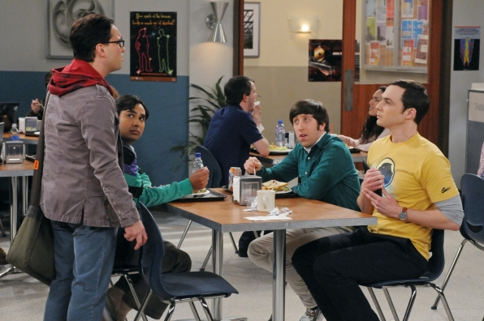
Finding a Place to Present

Slide 12


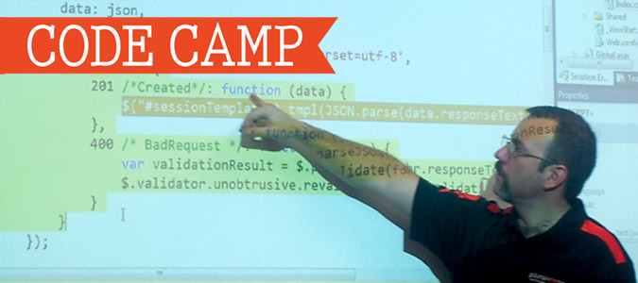

Finding a Place to Present

Slide 13
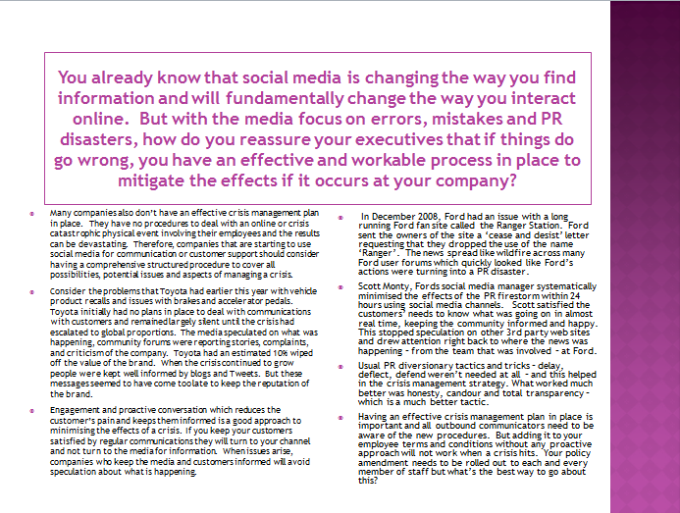
Building a Deck

Slide 14
Building a Deck

Slide 15
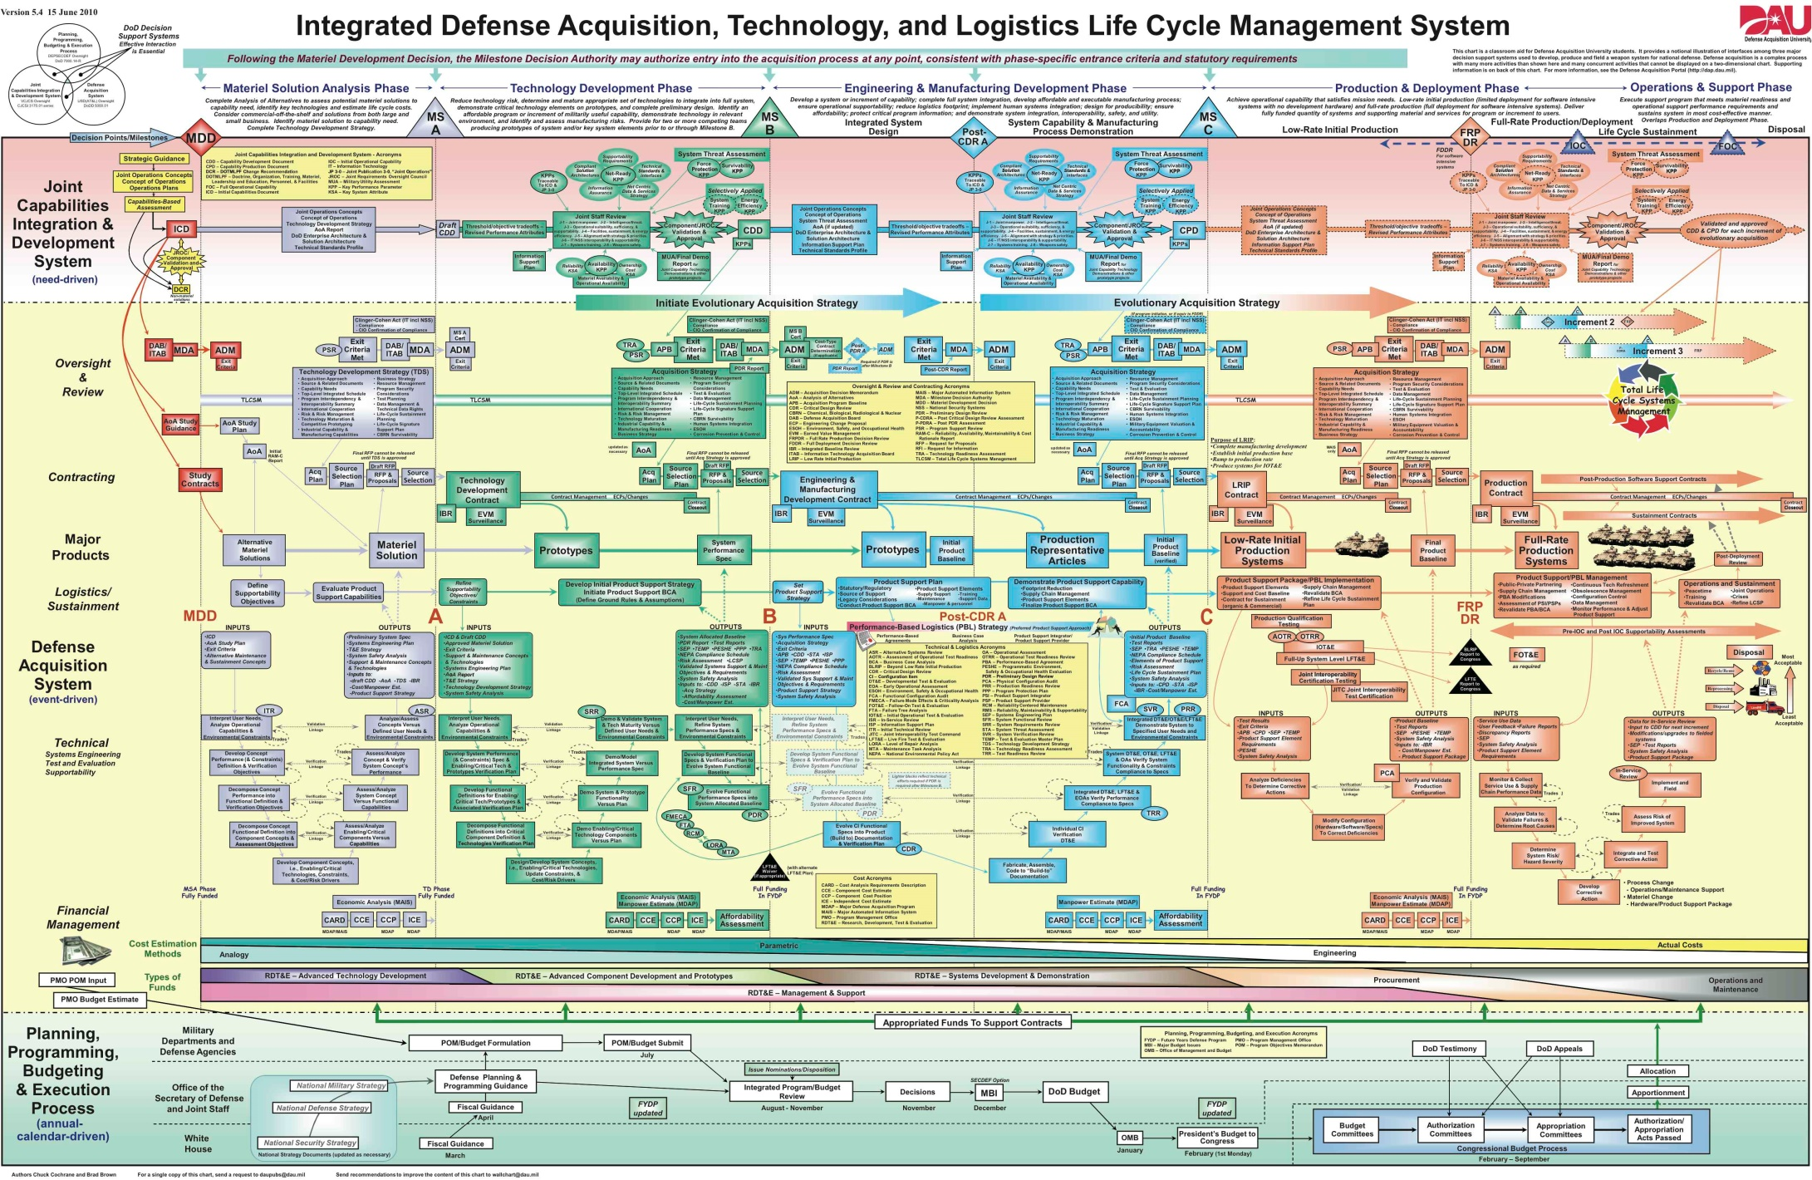

Slide 16
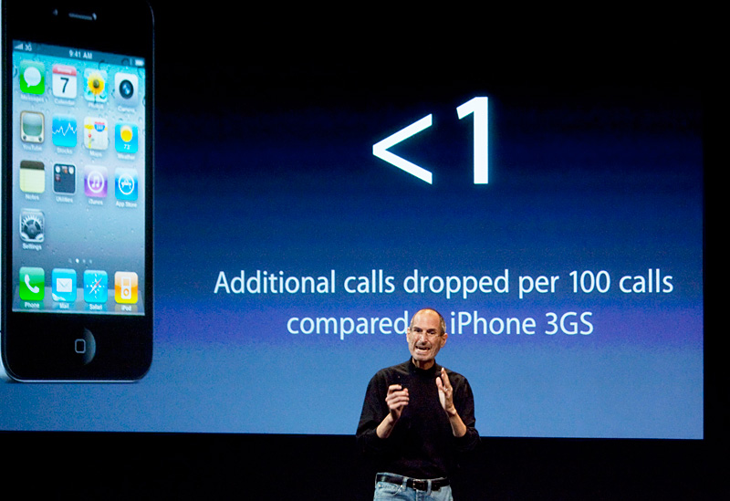
KISS

Slide 17
Building a Deck
Less is more
Use the deck as a guide
Use Notes
For Startup requirements (demo)
For hints on slides

Slide 18
Building a Deck
Start Simply
Title
Agenda
The End
References

Slide 19
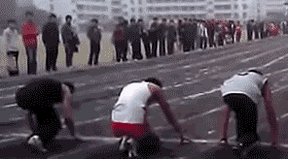
Demos

Slide 20
Demos
Use larger fonts (14+)
ZoomIt
Repeat Queries
Use Comments
Use Separate Slides for Demo in the deck

Slide 21

Practice

Slide 22
Practice
out loud
the full presentation
for friends/family
for time

Slide 23
Goals
Motivate you
Give you confidence
Give you a few practical tips

Slide 24
The End
Questions?
www.voiceofthedba.com
http://bit.ly/FirstTechSpeak
@way0utwest
Sjones at sqlservercentral . Com

Slide 25
References
http://sqlblog.com/blogs/adam_machanic/archive/2013/02/22/capturing-attention-writing-great-session-descriptions.aspx
http://www.garrreynolds.com/preso-tips/
Configure SSMS for presenting - http://www.sqlskills.com/blogs/paul/configuring-ssms-for-presenting/
ZoomIt - http://technet.microsoft.com/en-us/sysinternals/bb897434

Slide 26
Images
Keynote crowd - http://www.speakersroundtable.com/wp-content/uploads/2012/02/MDRlarge-crowd_4595.jpg
Database word tag cloud - http://t2.ftcdn.net/jpg/00/47/31/47/400_F_47314707_XbnyiEFaMcNzc65fL93UDNoKoxIlt6FH.jpg
Surprised Al Bundy - http://media.giphy.com/media/hkMXte9dBJFfO/giphy.gif
Counting money - http://www.savespendsplurge.com/wp-content/uploads/animated-gif-counting-money-bills-cash.gif
Adam – Writing Great Session Abstracts - http://sqlblog.com/blogs/adam_machanic/archive/2013/02/22/capturing-attention-writing-great-session-descriptions.aspx
Rosie grading - http://www.blogcdn.com/www.switched.com/media/2009/09/robotgrader.jpg
Big Bang Theory - http://www.cbs.com/shows/big_bang_theory/photos/82111/season-5-episode-15/6981/
Steve Jobs - http://robertferrucci.com/wp-content/uploads/2013/01/Jobs1.jpg
Bad PPT2 - http://www.wired.com/images_blogs/dangerroom/2010/09/atl_wall_chart.jpg
Bad PPT1 - http://eileenbrown.files.wordpress.com/2011/07/image4.png
Jog Fail - http://img0.joyreactor.com/pics/post/gif-fail-jogging-750656.gif
Math practice - http://pardington10.wikis.birmingham.k12.mi.us/file/view/math_animated_boy.gif/218719080/math_animated_boy.gif

